Slide 1
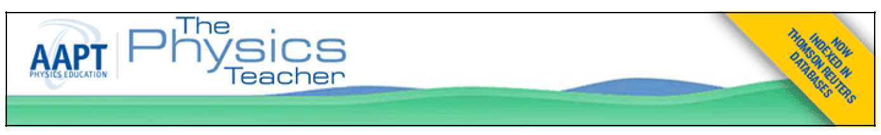
Turning a Common Lab Exercise into a Challenging Lab Experiment: Revisiting the Cart on an Inclined Track 翻轉一般普通實驗成一個具挑戰的創意實驗： 以運動車體在斜面運動的實驗為例
原文作者：Joseph C. Amato and Roger E. Williams, Colgate University, Hamilton, NY
引用：Citation: The Physics Teacher 48, 322 (2010); doi: 10.1119/1.3393065
網頁來源：View online: http://dx.doi.org/10.1119/1.3393065
目錄網站：Table of Contents: http://scitation.aip.org/content/aapt/journal/tpt/48/5?ver=pdfcov
原文發表：Published by the American Association of Physics Teachers
簡報製作：戴明鳳
(國立清華大學普物實驗室兼跨領域科教中心，2017/8/11

Slide 2
Related Articles you may be interested in
Magnetic Viscous Drag for Friction Labs,
Phys. Teach. 54, 335 (2016); 10.1119/1.4961172
2. Using particle tracking to measure flow instabilities in an undergraduate laboratory experiment
Am. J. Phys. 79, 267 (2011); 10.1119/1.3536647
3. Time Trials - An AP Physics Challenge Lab, Phys. Teach. 47, 342 (2009); 10.1119/1.3204112
4. A Block Dragging a Cart
Phys. Teach. 44, 114 (2006); 10.1119/1.2165444
5. Mini-Lab Reports
Phys. Teach. 41, L3 (2003); 10.1119/1.1753562

Slide 3
Introduction
A common lab exercise in the introductory college physics course employs a low-friction cart and associated track to study the validity of Newton’s second law.
Yet for college students, especially those who have already encountered a good high school physics course, the exercise must seem a little pointless.
These students have already learned to accept Newton’s laws without question, and any experimental data that contradict the second law would immediately alert students to an error in procedure or analysis, or, worse, reinforce the widely held opinion that simple laws are inadequate to explain the behavior of “real” systems.
A better approach is to ask students to apply their understanding of Newton’s laws to determine one or more unknowns inherent in the laboratory apparatus.
We illustrate this approach in the experiment described below: a small amount of complexity is added to a standard experimental exercise, forcing a careful analysis of the collected data and yielding very accurate results plus a thorough understanding of the physical system under study.
If development of experimental skills is one of the primary goals of the introductory laboratory, then the strategy illustrated below might be widely adaptable and appropriate in laboratories throughout the introductory mechanics curriculum.

Slide 4
簡 介
入門大學物理課程中常見的實驗練習之一：使用低摩擦車和相關軌道運動問題來探究牛頓第二定律的有效性。
但對於大學生，特別是已在高中接受過好的物理教育課程的學生來說，這個實驗看起來似乎頗沒有意義。
這些學生已經學會接受牛頓的法律，任何違反第二定律的實驗數據都會立即提醒學生去處理或分析錯誤；或者更糟的是，更加促使同學認為簡單的物理定律不足以解釋“真實”系統的行為。
較好的方法是：要求學生應用他們對牛頓定律的理解，以確定實驗室設備內部固有的一個或多個未知數。
下面描述的實驗中說明了此方法：在標準的實驗練習中加入了少量複雜性，並加強對收集之數據進行仔細分析，可以產生非常準確的結果，同時徹底了解正在研究的物理系統。
如果實驗技能的發展是介紹性實驗室的主要目標之一，那麼此處所說的策略應可廣泛適應和適用在力學介紹課程中的實驗中。

Slide 5
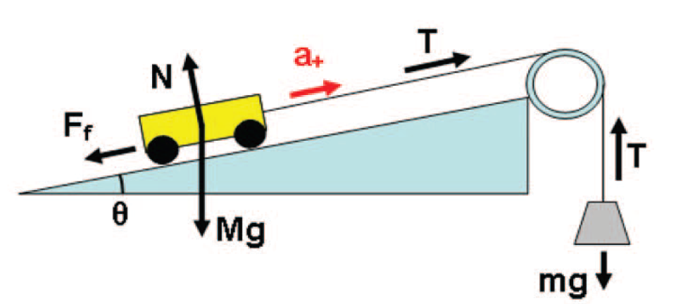
Procedures
In the standard experiment, a low-friction cart (of mass M), resting on a horizontal track, is attached by a lightweight string passing over a pulley to a hanging mass m.
When m is released, the cart accelerates and its velocity v vs time t, v(t) is measured by the pulley and its associated electronic apparatus.
The slope of v(t) is used to measure the acceleration a and then to “verify” Newton’s second law, using the easily derived result
Measure v(t)
⇨ a(t) & F(t), x(t)
Fig. 1. Schematic of the experimental setup. A low-friction cart of mass M on an inclined track is attached to a hanging mass m by a string passing over a photogate/pulley. The forces acting on the masses are shown.

Slide 6
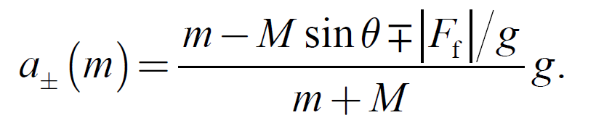
New Procedures
2. If, instead, the track is tilted by an unknown angle θ (typically about 3°), if M is unknown without friction effcet or including friction effect, students encounter a much richer problem, illustrated in Fig. 1.
If friction is not ignored,
for m significantly larger than Msin θ, the cart moves up the sloping track with an acceleration a₊;
for significantly smaller values of m, the cart descends the slope with acceleration a–.
(b) If the effective friction force is modeled as a constant force F_{f} opposing the motion, then
By measuring a(m) for numerous values of m, for both directions of motion,
⇨one can easily evaluate (1) the friction force F_{f}, (2)the unknown track angle θ, and, in particular, (3) the unknown cart mass M.

Slide 7
Confirmation of Measuring Results
The unknown cart mass M can easily be compared to a direct measurement using a triple beam balance (三樑天平), leading to a very satisfying result.
The same strategy has been used by other authors^{1,2} to determine the effective coefficient of friction of a cart rolling on a track.
While this is also an interesting application, there is no convincing way for students to evaluate the correctness of their work.
The evaluation of the cart mass M, which can be confirmed by direct measurement, makes for a more suitable lab exercise. See also Ref. 3.
Fig. 2 illustrates data v(t) taken using a photogate.

Slide 8
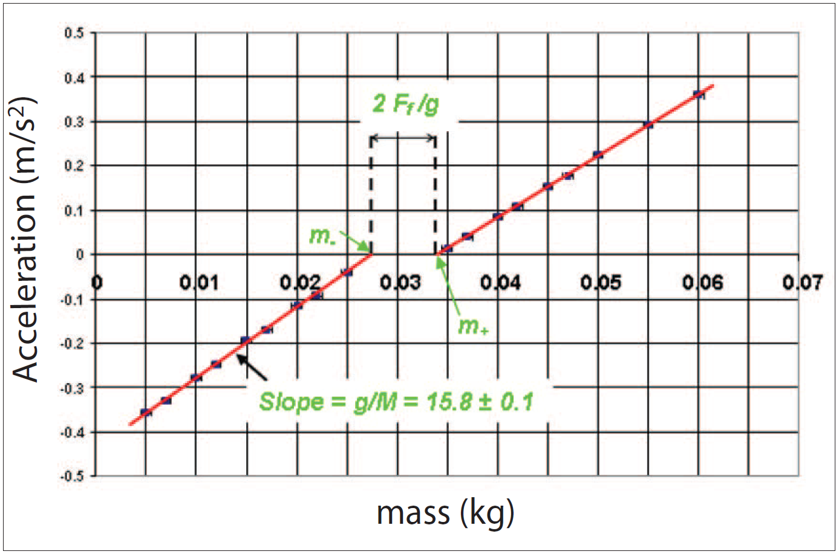
Data and analysis
The data v(t) (taken by a photogate) shall fall quite nicely onto two straight lines, with x-intercepts at m₊ and m₋ as shown in Fig. 2
(1) Solving Eq. (2) for the intercepts (a₊ = 0), to obtain F_{f} and M.
Similarly,
--Eq.3
--Eq.4
m₊ = 0.0341 kg
m– = 0.0276 kg.
F_{f} = 0.032 N
M = 0.031/sinθ = 0.613 kg
In this example,

Slide 9
Fig. 2. Acceleration of M vs mass m.
1. The x-intercepts m₊ and m₋ are used to determine
(a) the effective force of friction acting within the cart-and-pulley system, and
(b) the value of the track angle θ.
2. The slope of the best-fitting straight line for m < m₋ yields the cart mass M.

Slide 10
Suggestion for Instructor
At first students are bewildered by the shape of their data plot.
Often, their initial strategy is to fit a single straight line through all of their data (using the familiar “trendline” option in Microsoft Excel), completely ignoring the obvious friction dependent kink between m₊ and m–.
This leads to an unacceptably large error in the evaluation of M.
Students are delighted to learn that the kink is real, that it is predicted by Eq. (2), and that a careful analysis guided by the correct equation of motion leads to very accurate results. Physics works!
No two setups have the same values of M or θ, so each group must work independently. (Each cart carries a small rectangle of brass secured to the cart surface by double stick tape.)
Only one beam balance (controlled by the instructor) is available in the laboratory, and students are not allowed to measure M until after they have completed their analysis.
The grade is determined largely by the accuracy of their calculated value of M.
Although this may seem harsh, we have found that simple, concrete grading criteria such as this are welcomed by students, and often result in higher quality lab reports as well as higher satisfaction with the lab.

Slide 11
References
Páll Theodórsson, “A new dynamics cart on an inclined plane”, Phys. Teach. 33, 458-459 (Oct. 1995).
Roger F. Larson, “Measuring the coefficient of friction of a low friction cart”, Phys. Teach. 36, 464–465 (Nov. 1998).
Barbara S. Andereck, “Measurement of air resistance on an air track”, Am. J. Phys. 67, 528–533 (June 1999).
The simpler situation of a block sliding with friction (F_{f} =μ_{k}Mg) over a horizontal (sinθ = 0) surface is solved in R. A. Serway and J. W. Jewett Jr., Principles of Physics, 4th ed. (Brooks-Cole, Belmont, CA, 2006), p. 131.

